Slide 1
Aaron Riggs, Andre Manz, Chris Baierski, Wesley Scott as
DrinkTank Present
Phil The automated bartender (Implementation Plan - Pouring Drinks)

Slide 2
What is PHIL again?
P.H.I.L.
Please Have Infinite Liquor
Goals
Reduce operating cost and loss for a bar to operate under rush conditions.
Reduce the amount of drinks that are over poured and spilled.
Reduce the amount of menial drinks that are made by the bartender.

Slide 3
Step 1 - GUI
Tkinter package is an object-oriented set of widget classes native to Python
The Good: Very fast and responsive GUI since it is native to Python
The Bad: Known for it’s outdated look and feel
This is ideal for our first iteration of PHIL, as we require proof of concept that we can get it to work properly; doesn’t matter if it isn’t pretty.

Slide 4
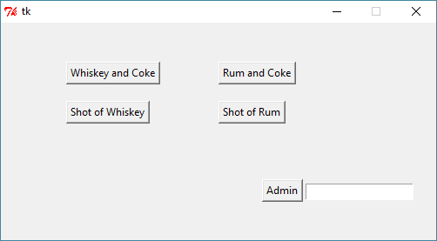
Step 1 - GUI
As most of us probably know, at the foundational level, a GUI is simply a window frame containing widgets/components that listen for events.
When pouring a drink our widget (Button) listens for the user event (Click).
The corresponding function then interfaces with the hardware to control the pumps and liquid flow.

Slide 5
Step 2.1 - Raspberry Pi
The Brain of PHIL
Controls the pumps and valves
Controls the voice activation system
Controls the business logic
Controls pouring ratios

Slide 6
Step 2.2 - Arduino
Acts as a passthrough for the RPi
Does direct control for the motors
Controls current flow for the I/O logic wires

Slide 7
Step 3 - Database
SQLite
Current Schema
drinkConfig(drinkName: varchar(255), liquor1: varchar(255), liquor2: varchar(255), soda1: varchar(255), cost: decimal(2, 2))
drinkSales(saleId: integer, drinkName: varchar(100), timestamp: datetime)
Future additions
Payment confirmation
More liquor/mixer options

Slide 8
Step 3 (ex) - Business Logic
onUpdateDrinkList: INSERT INTO drinkSales(drinkName) VALUES(‘drinkName’)
onRequestSales: SELECT SUM(dc.cost) FROM drinkSales AS ds, drinkConfig AS dc WHERE ds.drinkName = dc.drinkName AND timestamp BETWEEN ‘fromDate’ AND ‘toDate’

Slide 9
Python Middleware
import sqlite3
connection = sqlite3.connect('phil.db')
cursor = conn.cursor()
fromDate = '2018-10-28'
toDate = '2018-10-29'
cursor.execute("SELECT SUM(dc.cost)
FROM drinkSales AS ds, drinkConfig AS dc
WHERE ds.drinkName = dc.drinkName AND timestamp BETWEEN ? AND ?", (fromDate, toDate))
print cursor.fetchall()
connection.close()

Slide 10

Step 4 - Voice Control
Mycroft AI
Wake Word Detection
Speech to Text
Intent Parser
Text to Speech
Will develop Mycroft “Skill” to interface with PHIL Functions

Slide 11
Implementation Update
RPi initialisation subroutines are making startup activate all the pumps
The RPi requires an independent power source because of the power draw of the LCD screen
The Valve is allowing flow even when closed
PHIL is able to pour drinks
The GUI and backend have taken significant steps forward

